Slide 1
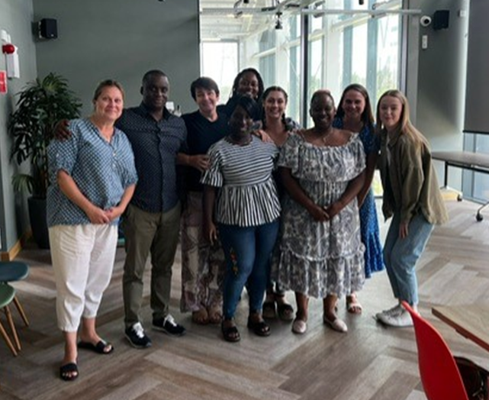
Are you worried about you child’s mental health and wellbeing?
Why not talk to us?!
We are the PCAS team.
PCAS stands Primary Care Access Service. It is your link between your GP and the Bedfordshire Child and Adolescent Mental Health Service (CAMHS).
We see assess and treat young people, under the age of 18, who are struggling with low to moderate mental health difficulties.
We can also signpost you to resources and organisations that can offer various help to improve the wellbeing of young people.
We will be holding drop-in sessions in your surgery. You do not need to book a time, just come along to your surgery and ask to speak to the PCAS team on the following dates:
Larksfield and Arlesey Surgery
Wednesday 13th March 2024, 1pm – 4pm
Friday, 19th April 2024, 10am- 1pm
This will be an informal, anonymous chat about any worries you have. We can direct you to help, resources or suggest an assessment with us.

